Slide 1
What’s Up Doc?
Transforming Information Literacy Instruction with Documentary Films
By Carrie Dunham-LaGree
Drake University
Librarian for Digital Literacy & General Education
Assistant Professor of Librarianship

Slide 3
Background

Slide 4

My Instruction Background
University at Albany
  1-credit information literacy courses
Drake University
  2-credit information literacy course
Notes:
Albany
1-credit course
6-8 weeks
11 times
Drake→Hooray!
2-credit course
Semester length
Result: largely the same: disinterested students

Slide 5

Drake’s Information Literacy background
One of 10 AOIs (Areas of Inquiry)
Few courses meet requirement
Notes:
One of 10 AOIs (Areas of Inquiry)
Few courses meet requirements
Those that do filled with seniors

Slide 6
J-Term

Slide 7



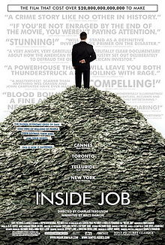


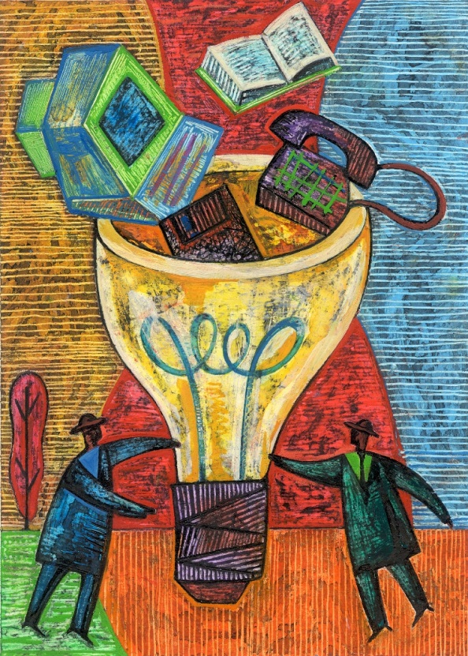






J-term: The New Frontier
Notes:
2012 (photos: calendar, thought bubble, snow, documentary collage
January term: what it is (optional, new, a week in a day)
Fall 2011: how can I make information literacy course more interesting?
How can I teach info lit in a 3-week term?
Epiphany: documentary films
Use of pop culture clips

Slide 8



J-Term 2013: Challenges
Notes:
Original idea: spend summer 2012 watching documentaries and creating individual research assignments utilizing as many databases and print resources as possible
Then, reality set in!

Slide 9
J-term 2013: Practicalities & Realities
Build from successes
Be flexible
Use what you have:
  Existing assignments
  Existing collections
Plan for Spring 2013 too
Notes:
I already had assignments outlining different databases and resources: adding documentary assignments around them; 5 students became 9; why put all this work into 3 weeks→test-drive it in Spring full semester too

Slide 10
J-Term 2013: What Was New
Response papers
Comparative project
Creative final project
Notes:
What’s New

Slide 11


J-Term 2013: The Results
Notes:
Most fun I’ve ever had teaching
Research beginning while we’re watching the movie
Drawbacks: so, so tired; calendar not sustainable every year

Slide 12
Spring Semester

Slide 13
Spring 2013
Notes:
On a high entering spring semester→ engagement dip
½ students already fulfilled Info Lit AOI

Slide 14
Going Forward
Different assessment needs
14 classes in 14 days is not the same as 14 weeks
2014: J-term
…and spring
Notes:
Different assessment needs
Less time is actually more!
Feedback loop: from 9 students to 20 in J-term

Slide 15
One-shot sessions

Slide 16
The First Year Seminar Program
Background
Challenges
….A Solution
Notes:
45 sections of 19 students
Taught by faculty/staff across the university
Topic: anything
Goal: emphasize critical reading, critical thinking, information literacy and writing
What do we do with the classes with no required research?
3:02

Slide 17
The Assignment
Your turn: generate research ideas
Have students vote on 4
Assign each idea a database/resource
Challenge:
  find the best source you can
  Demonstrate how and why
Notes:
Your turn: generate research ideas
Show don’t tell!

Slide 18

Questions?
carrie.dunham-lagree@drake.edu
@DrakeLibrarian

